Slide 1
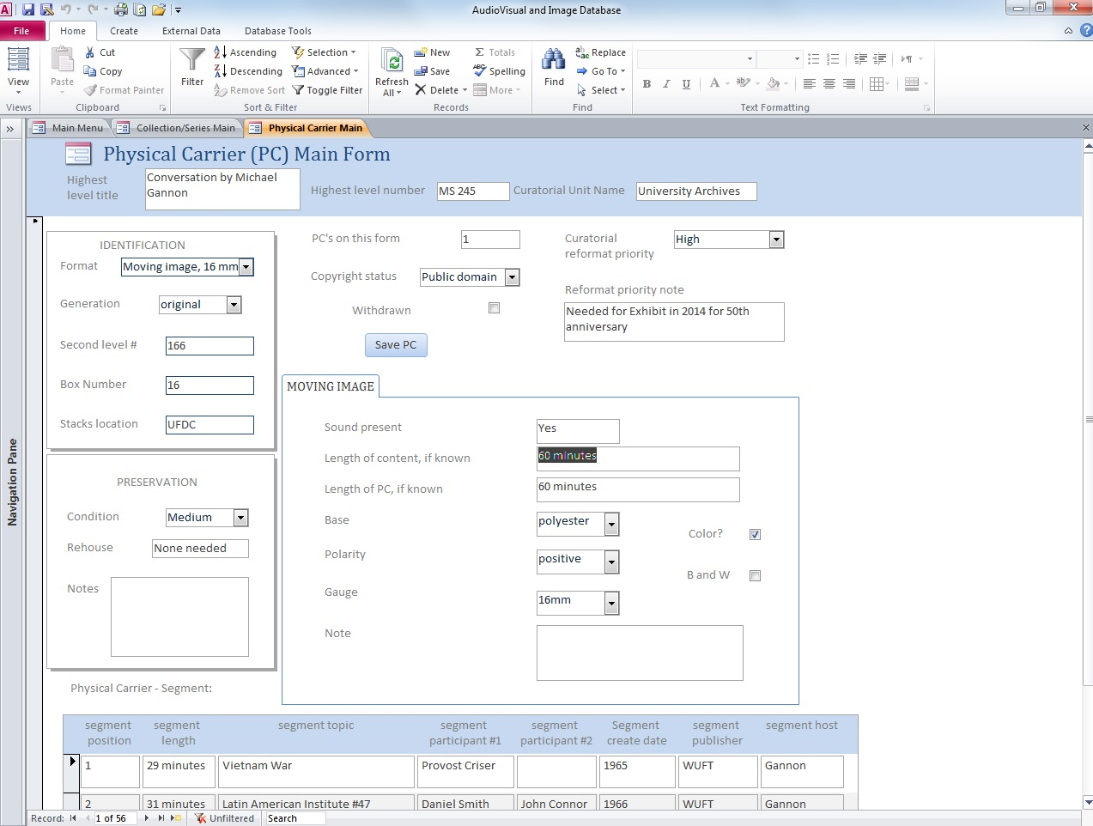
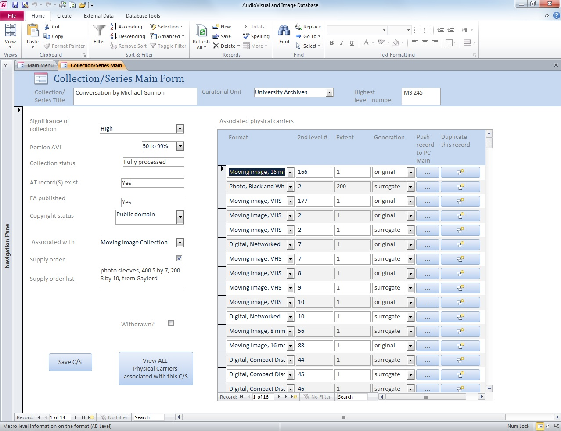
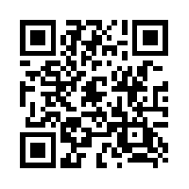
AVID: a special format management tool:
Cathy Martyniak, Audiovisual and Image Archivist
Special and Area Studies Collections, George A. Smathers Libraries
What is AVID (Audiovisual and Image Database)? AVID is an MS Access based tool designed to manage activities associated with physical A/V and Image objects stored in archival and library collections. Preservation concerns, storage location, and copyright status can be tracked at the collection and individual item level within the desktop application.
Work flow support:
Track objects by format
Relate objects at the ‘collection level’
Allow description of objects at the ‘item level’
Import and export data from other applications
Establish preservation and digitization priorities
Generate reports and statistics
Associate original objects with their surrogates
Audio:
Length of content
Length of carrier
Base
Speed
Spoken word
Notes
Photographs:
Size
Type
Extent
Polarity
Notes
Moving Images:
Sound present
Length of content
Length of carrier
Base
Speed
Polarity
Gauge
Color
Notes
Data tracked by format include:
Screen capture of Physical Carrier form
Screen capture of Collection/Series form
http://library.ufl.edu/spec/AVID
Email cmook@ufl.edu for more information

