Slide 1
Documenting Provenance: Out of Our Heads and into the Database Mike Brostoff, Academy Film Archive Stephen Danley, Academy Film Archive Stephanie Sapienza, Maryland Institute of Technology in the Humanities
Notes:
Assumption: Attendees understand the relevance of Provenance
Disconnect versus unconnect
Panelist introduction
Stephen and I at Academy – provenance for moving image items
Me: developing infrastructure and workflows
Stephen: documentation and examples
Stephanie: the value of paper documentation accompanying media collections

Slide 2
“Default” Workflow
Curatorial staff appraise and select potential collections and negotiate terms of donation/deposit.
Pre-acquisition
Acquisition staff arrange contracts, coordinate shipping and create acquisition record(s).
Acquisition
Inventory
Archivists inspect, process and enter information in database on per item basis.
Cataloging
Catalogers verify information in records and add credits, subject headings and summaries.

Slide 3
The “Un-connects”
No formal channel for communicating collection level information between staff working in different phases of the work flow.
No guidelines or requirements for documenting collection level information.
Months after the record is created, Cataloging works on content level. Don’t see the records as part of larger collection. Default cataloging applied without consideration of nuances of collection.

Slide 4
Provenance Workflow
Pre-acquisition
Cataloger oversees and audits acquisition information
Acquisition
Collection Team Meeting
Inventory
Coordinate communication between Archivists and Catalogers
Cataloging
Collection Write-up

Slide 5
Collection Team Meeting
Assemble all staff members who are involved with the collection
Opportunity for staff to share knowledge of the collection
Make sure important questions are asked: -What is the scope and nature of the collection? -Why and how was the collection acquired? -What is the relationship between the source and the materials? -What parts of the collection are we receiving? What are we not getting and why?
Determine the levels of inspection and cataloging
Record audio of the meeting
Side Benefit: learning the details and challenges of co-worker’s jobs

Slide 6
Collection Team Roles
Initial Contact
Researcher
Contract Administrator
Processor(s)
Cataloger
Writer
Case Officer
Source Contact (optional)
Material Specialist (optional

Slide 7
Meta-Documentation
Correspondence with Donors/Depositors
Centralize physical and electronic documentation
Academy uses Sharepoint for electronic documents – benefit of meta data fields

Slide 8
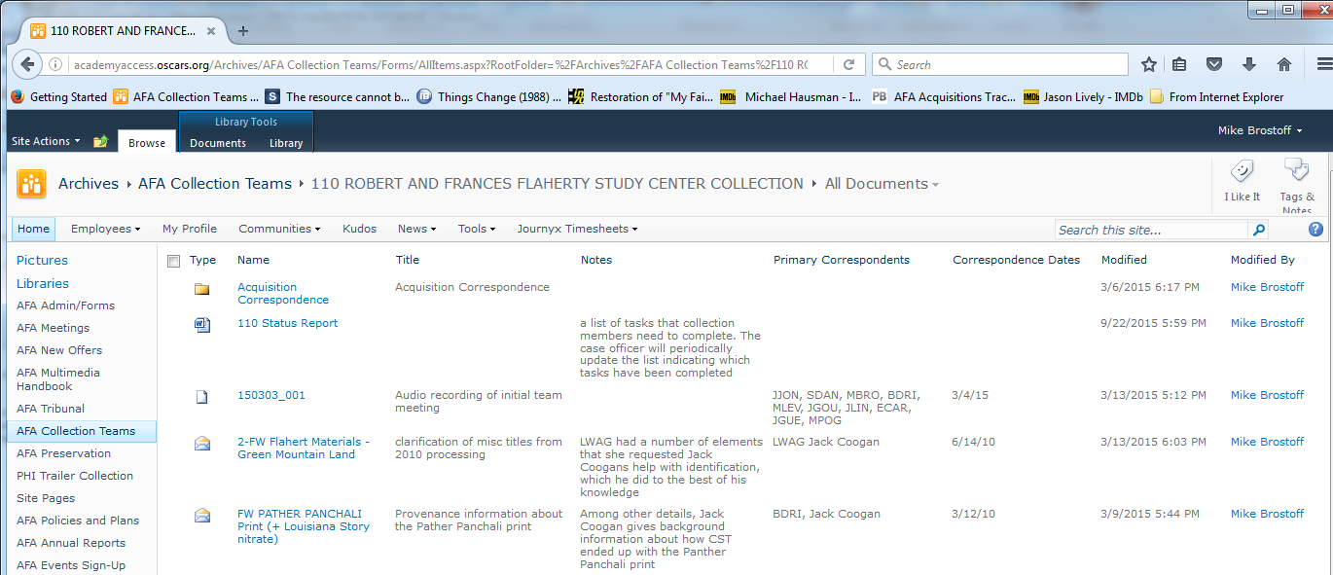
Sharepoint

